Slide 1
Trucking Risk Analysis Using Spark
Submitted by :
Pranav Sheth (810028118)
Dev Patel (828593772)
Prof: TSENG-CHING JAMES SHEN

Slide 2

Table of Content
Problem Statement
Objective
Implementation Approach
Discussion on Results
Driver risk factor prediction
Conclusion

Slide 3
Problem Statement
TRUCKING
Challenges in effectively ensuring and enforcing compliance among all drivers within the fleet poses a significant threat to the company's operational efficiency, financial stability, and overall reputation.
C O M P A N Y

Slide 4
Objectives
Implement measures to enhance driver safety, reduce accidents, and minimize associated costs such as insurance premiums and vehicle repairs.
Increase revenue generation and optimize cost-effective operations to enhance overall profitability in trucking operations
Streamline processes, improve resource utilization, and reduce downtime to enhance operational efficiency and minimize associated costs.
TRUCKING
C O M P A N Y

Slide 5
Implementation Approach
Data Ingestion:
Raw Data Storage: Data is initially fed into an AWS S3 bucket. This involves storing raw trucking data such as mileage, gas usage, geolocation, events, and driver specifics in a structured CSV format.

Slide 6
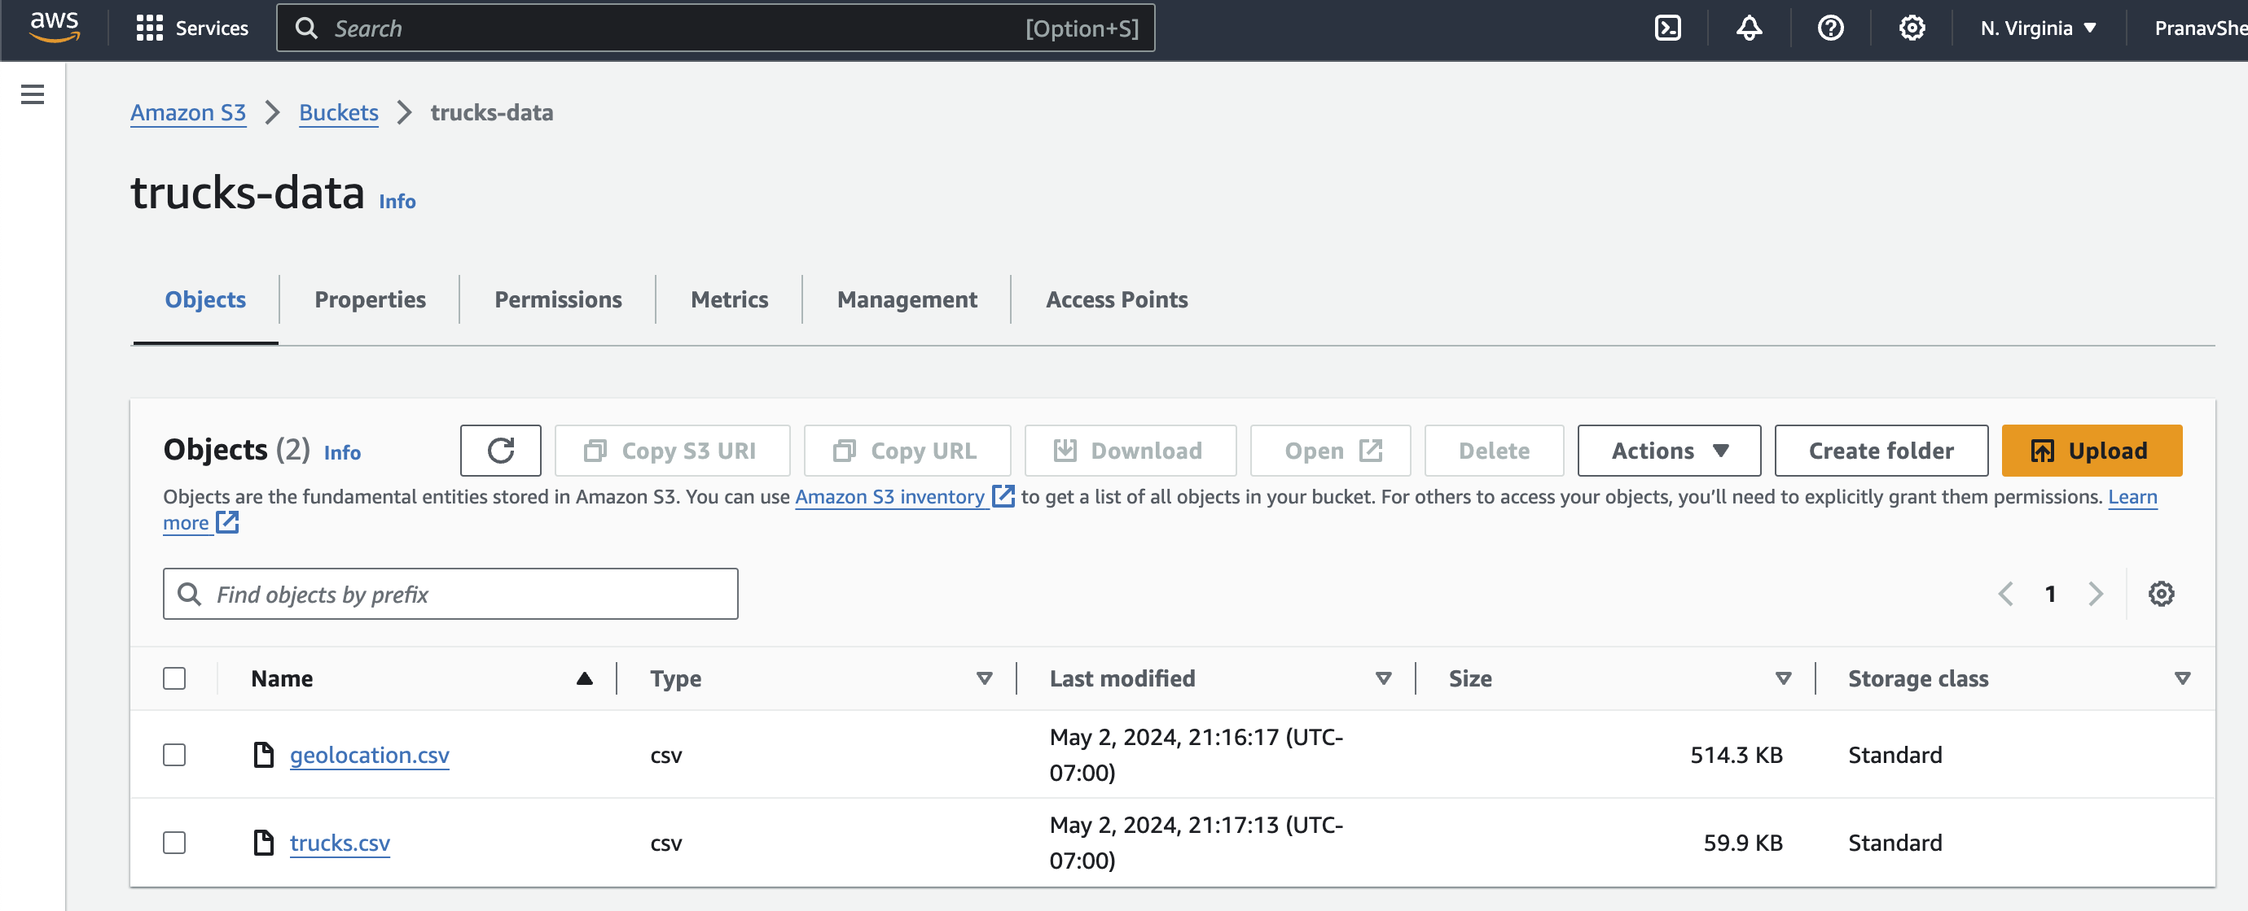
Implementation Approach

Slide 7
Implementation Approach
Data Processing and Transformation :
Spark Session Initialization: Establish a Spark session named "Trucking Risk Analysis" using Databricks to enable data manipulation and analysis capabilities.
Schema Definition:
Truck Schema: Dynamically define a schema that includes fields for driver ID, truck ID, model, and detailed monthly data on mileage and gas spanning from January 2009 to June 2013.
Geolocation Schema: Define a schema for geolocation data that includes fields for identifying truck and driver details, event types, velocity, event indications, and idling indications.

Slide 8
Implementation Approach
Data Exploration: Display initial rows from the loaded Dataframes to verify the data structure and integrity.
Data Loading: Load the data from the S3 bucket into Spark Dataframes according to the predefined schemas using the CSV format. This includes separate Dataframes for trucks and geolocation data.

Slide 9
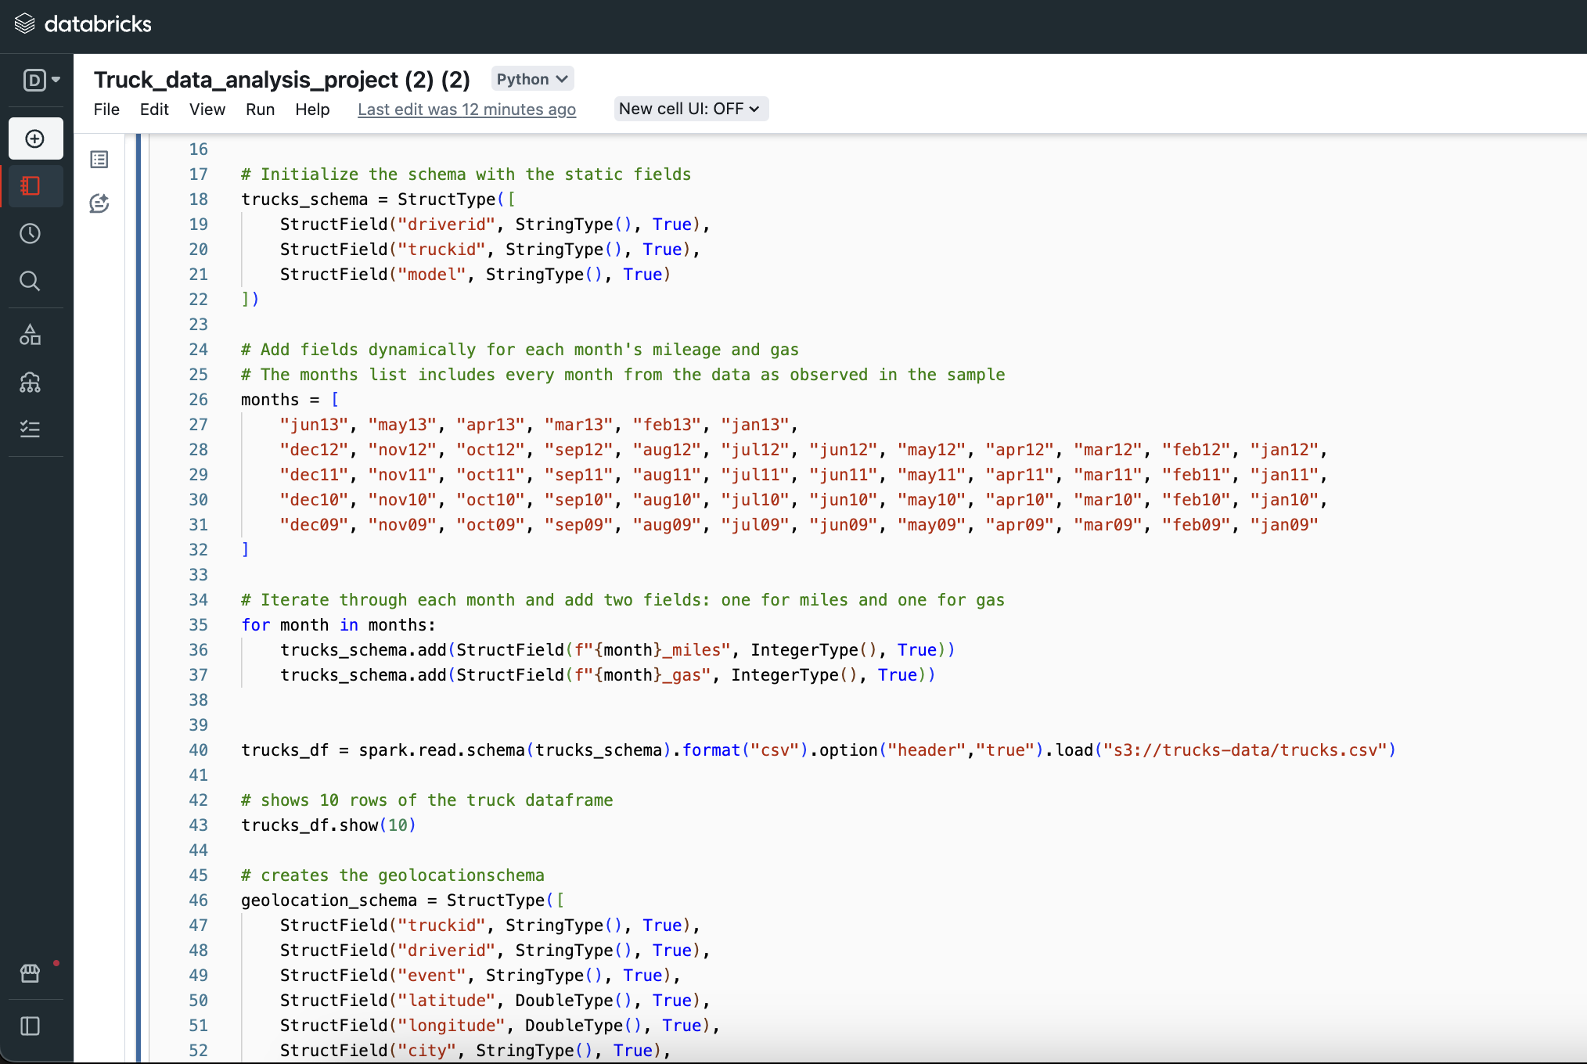
Implementation Approach

Slide 10
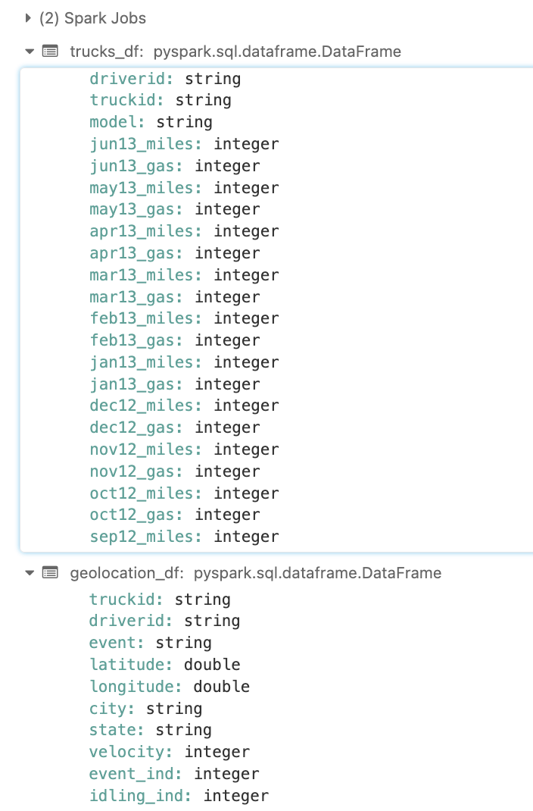
Implementation Approach

Slide 11
Implementation Approach
Data Transformation Using PySpark
Event Analysis:
Extract and filter data for each driver to analyze events other than normal operations.
Group by event types to count occurrences for each driver, which helps in identifying frequent anomalies or risky behaviors.
Risk Analysis:
Join data on driver IDs from total miles driven and total event occurrences to compile comprehensive driver profiles.
Calculate a 'Risk Factor' for each driver as the number of event occurrences per million miles driven, which provides a standardized measure of risk.

Slide 12
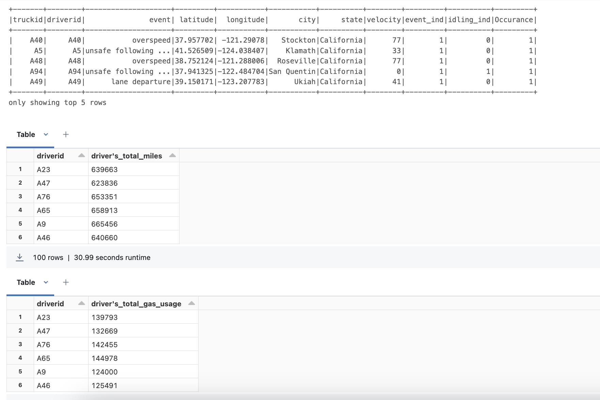
Implementation Approach

Slide 13
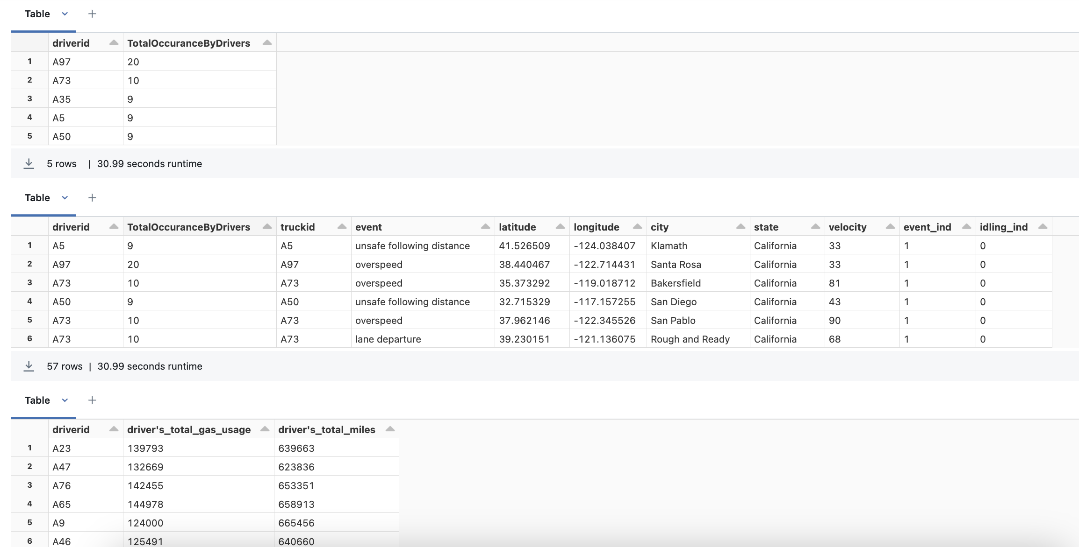
Implementation Approach

Slide 14
Discussion on the Results
Driver Efficiency Scatter Plot:
Purpose: To display the fuel efficiency of drivers.
Analysis: By plotting efficiency (miles per gallon) against driver IDs, one can identify which drivers are the most fuel-efficient. This is useful for recognizing patterns of efficiency and possibly correlating them with other behaviors or attributes (like routes, vehicle types, or driving habits).
Conclusion: Drivers who consistently show higher efficiency might be considered for rewards or used as models for training less efficient drivers. Conversely, drivers with low efficiency could be targeted for additional training or vehicle maintenance checks.

Slide 15
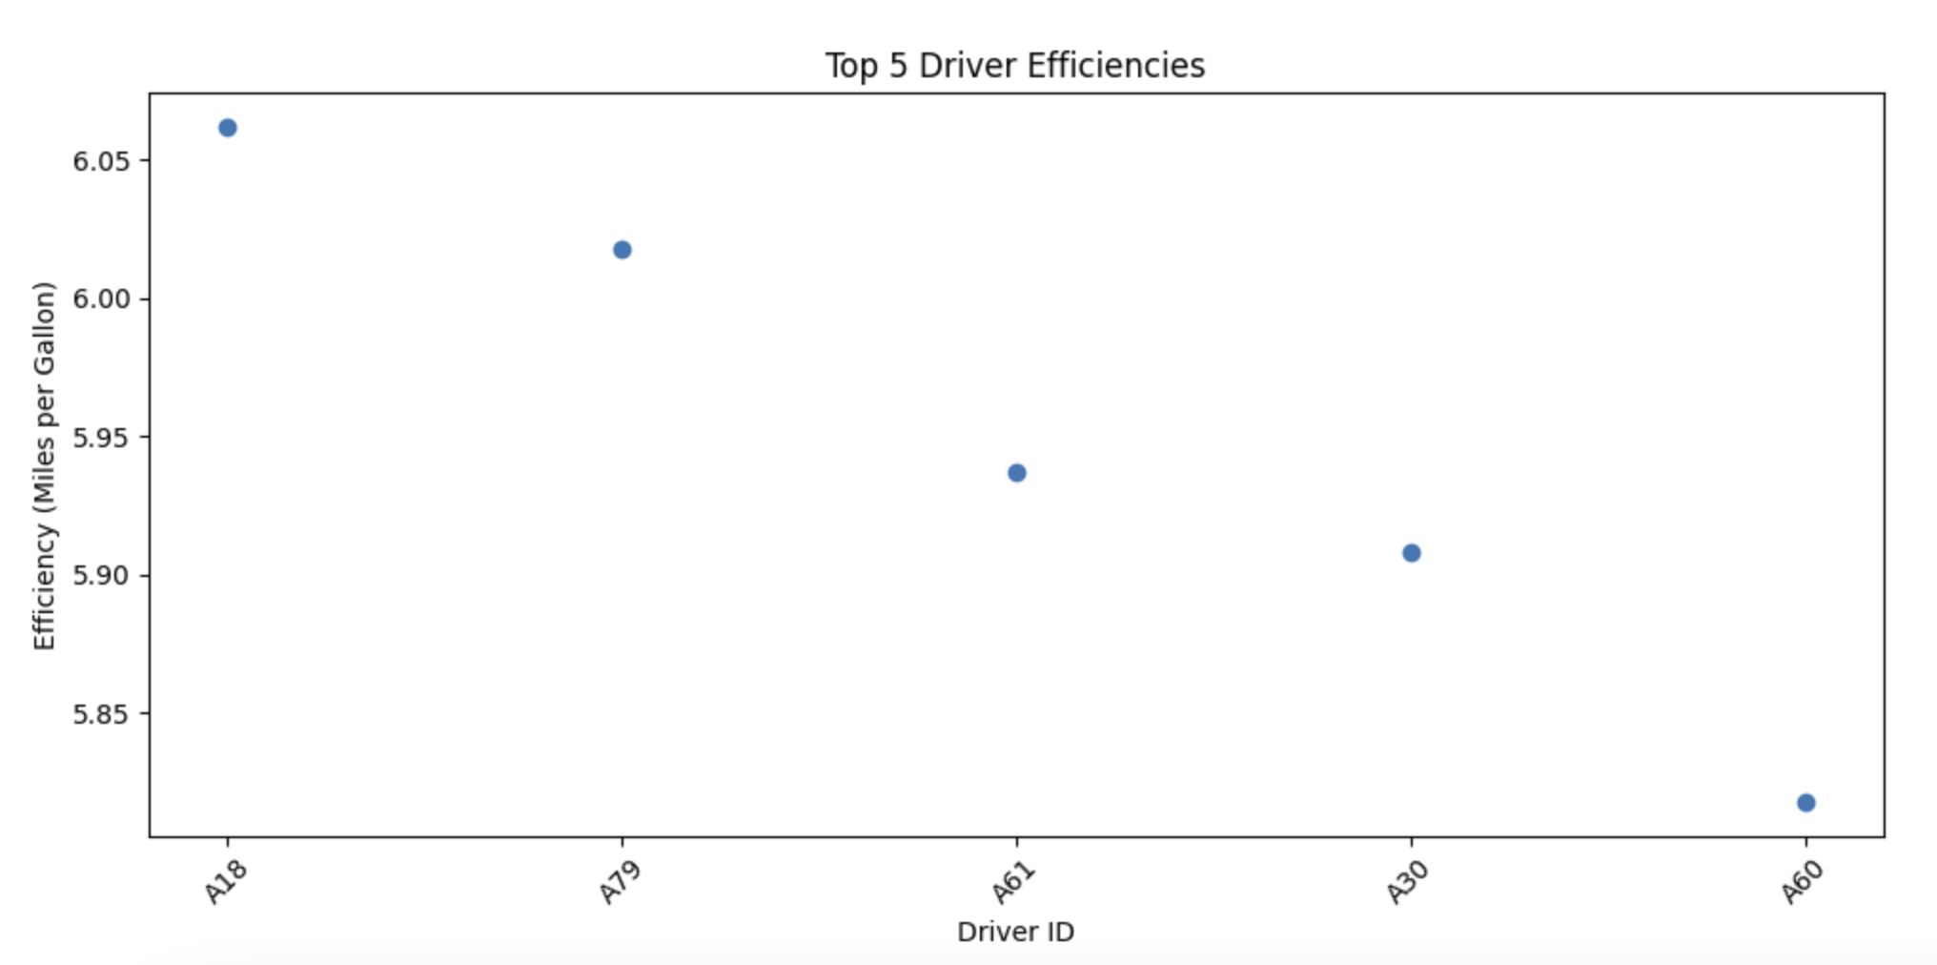
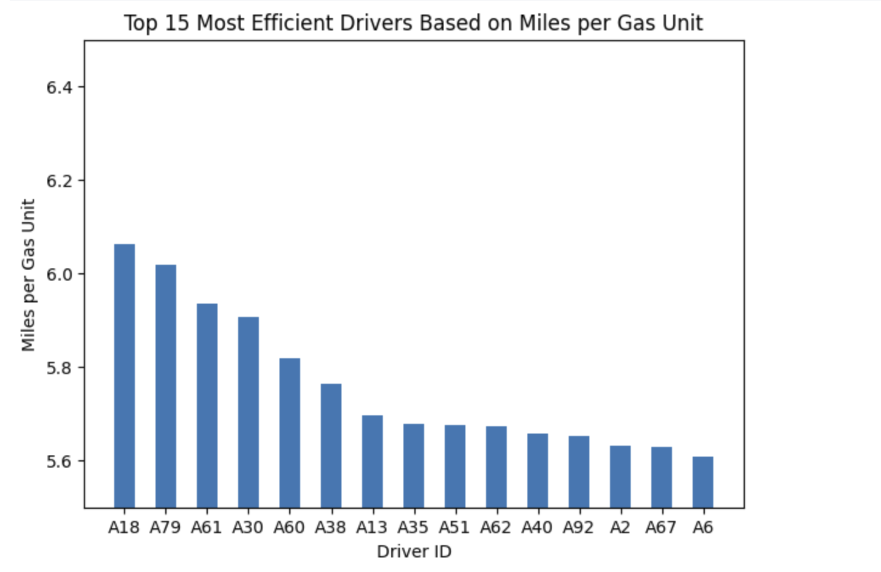
Discussion on the Results

Slide 16
Discussion on the Results
Event Counts Bar graph:
Purpose: To show the frequency of various types of driving events.
Analysis: This horizontal bar plot helps in understanding which events are most common across the data set. High-frequency events might indicate common challenges or areas where driver behavior could be improved.
Conclusion: By focusing safety training and operational improvements on the most common events, the organization can potentially reduce their occurrence and improve overall safety metrics.

Slide 17
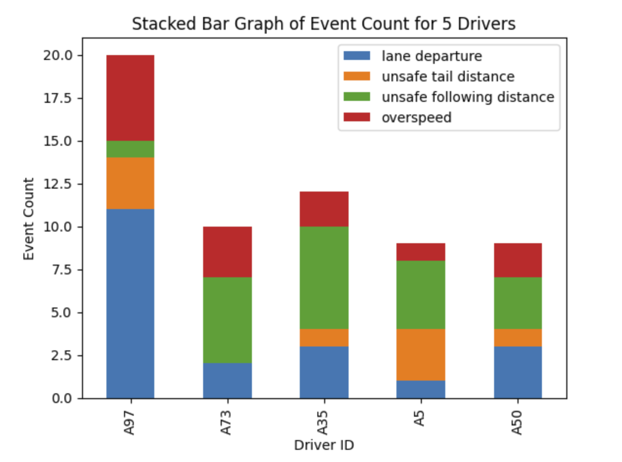
Discussion on the Results

Slide 18
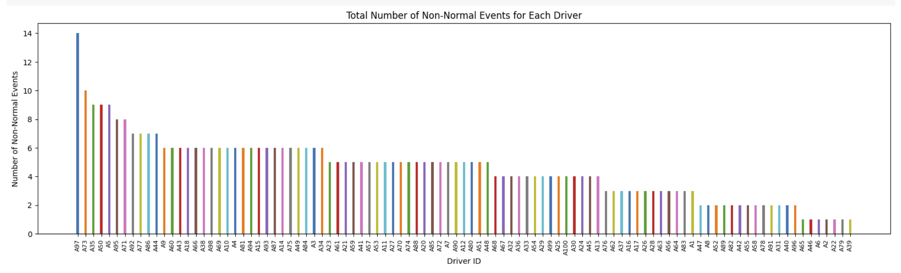
Discussion on the Results

Slide 19
Discussion on the Results
Events by Risky Driver Scatter Plot:
Purpose: To illustrate how often different unsafe driving events occur.
Analysis: The chart shows that Lane departures is the most frequent event, followed by unsafe following and tail distances. over speeding are less common but still concerning.
Conclusion: Addressing speeding and safe distance practices through targeted training and enhanced monitoring could significantly improve road safety.

Slide 20
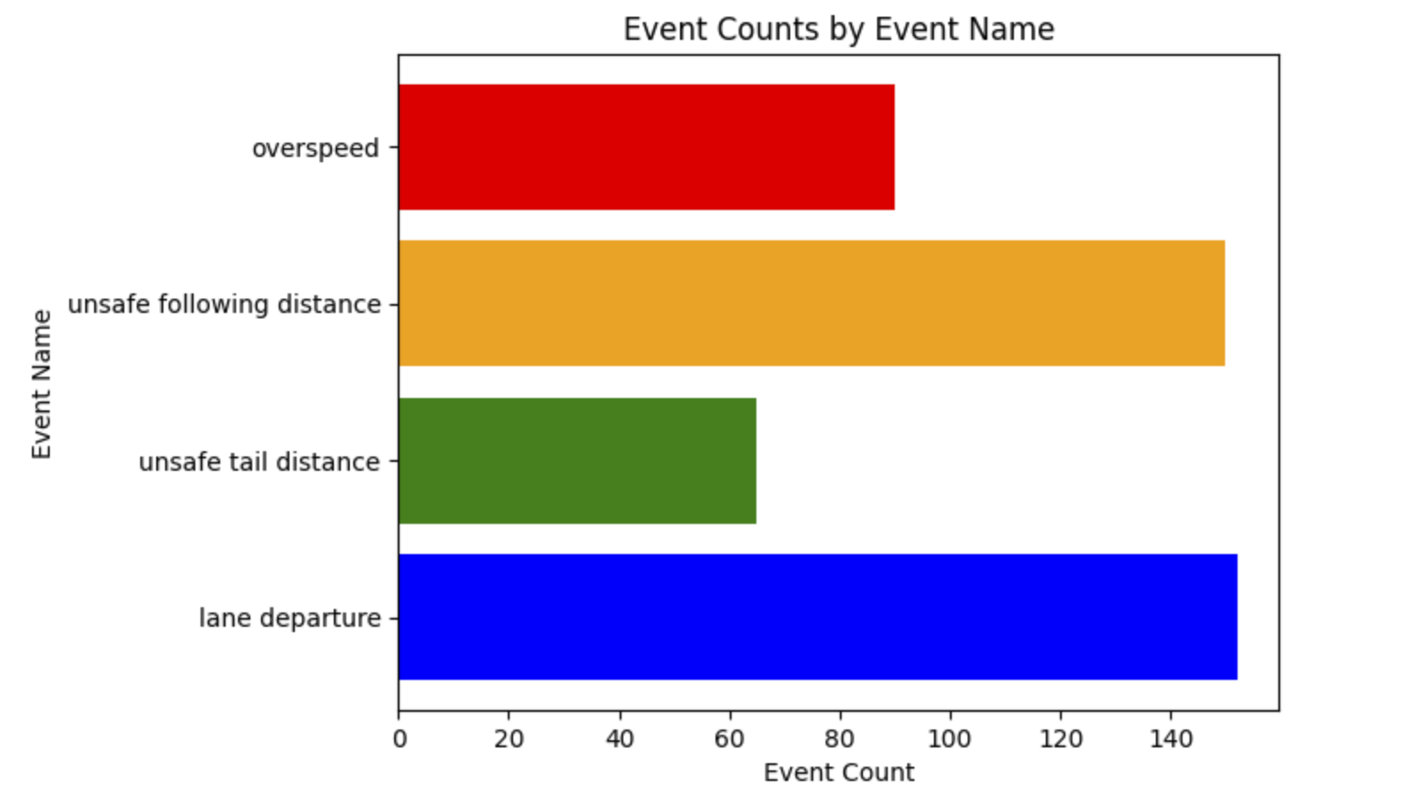
Discussion on the Results

Slide 21
Discussion on the Results
Top 5 Cities with Events Scatter Plot:
Purpose: To focus on urban centers with a high frequency of events.
Analysis: By pinpointing where significant events occur, particularly in urban settings, this plot provides insights into geographic and possibly urban-specific challenges (like dense traffic or complex intersections).
Conclusion: City-specific strategies, including collaboration with local traffic management authorities, could be developed to address unique challenges faced in these areas.

Slide 22
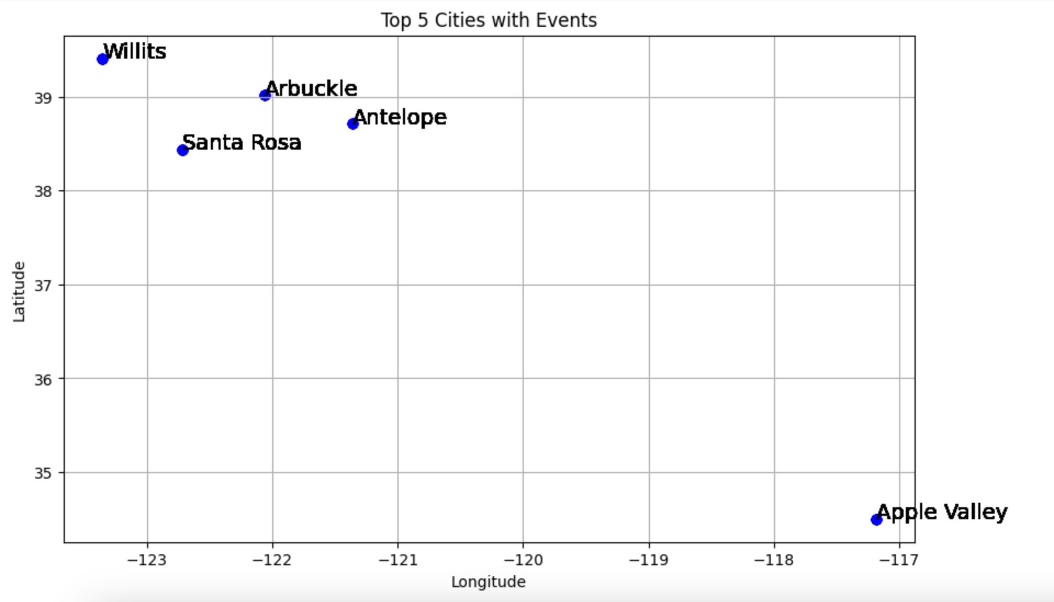
Discussion on the Results

Slide 23
Discussion on the Results
Top 5 Risky Drivers Line Plot:
Purpose: To rank drivers by their associated risk factors.
Analysis: A line plot showing risk factors associated with individual drivers helps in quickly identifying those who may require immediate intervention due to their high-risk profile.
Conclusion: Prioritizing interventions for these drivers could include advanced driving courses, more frequent vehicle inspections, or even behavioral counseling if needed.

Slide 24
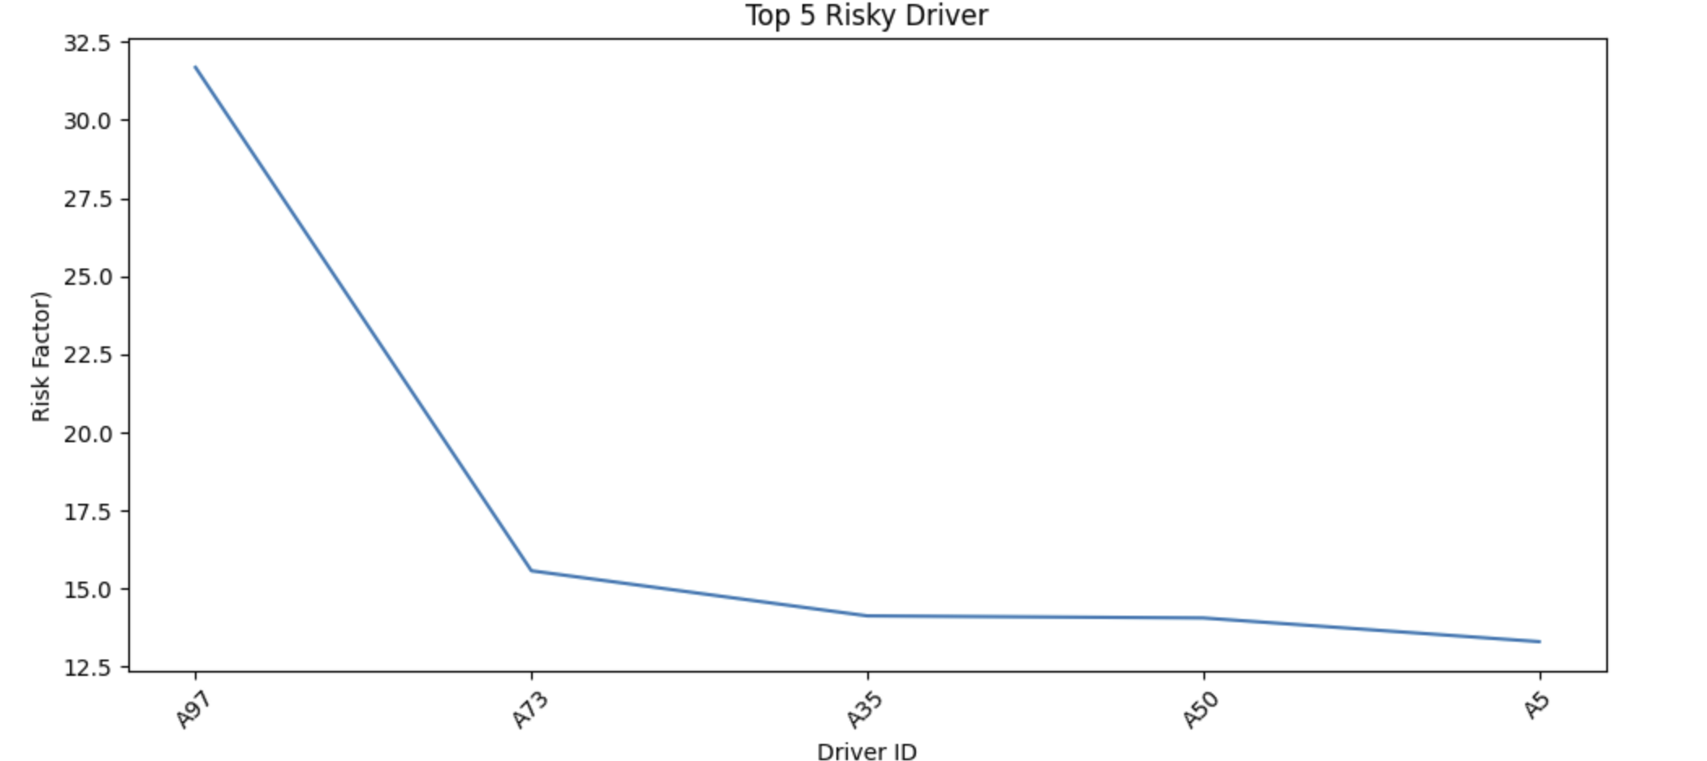
Discussion on the Results

Slide 25
Driver risk factor prediction
Objective:
Utilize machine learning to predict risk factors for truck drivers based on driving behavior and historical data.
Data Sources:
Historical truck logs detailing monthly mileage and gas usage.
Event data from geolocation tracking capturing non-normal driving events.
Approach:
Integration and cleaning of truck and geolocation data to compute total miles and adverse driving events for each driver.
Calculation of risk factors as adverse events per million miles.
Modeling Technique:
Linear Regression used to model the relationship between driving behaviors (miles and events) and risk factors.

Slide 26
Driver risk factor prediction
Model Insights:
Key predictors of risk include the frequency of non-normal events and total mileage.
Higher event counts significantly correlate with increased risk factors.
Implications:
Predictions can guide targeted interventions for drivers at higher risk, potentially reducing accident rates and enhancing road safety.
Data-driven insights can help refine driver training programs and operational protocols.
Future Directions:
Incorporation of additional data such as real-time traffic conditions and weather data to enhance prediction accuracy.

Slide 27
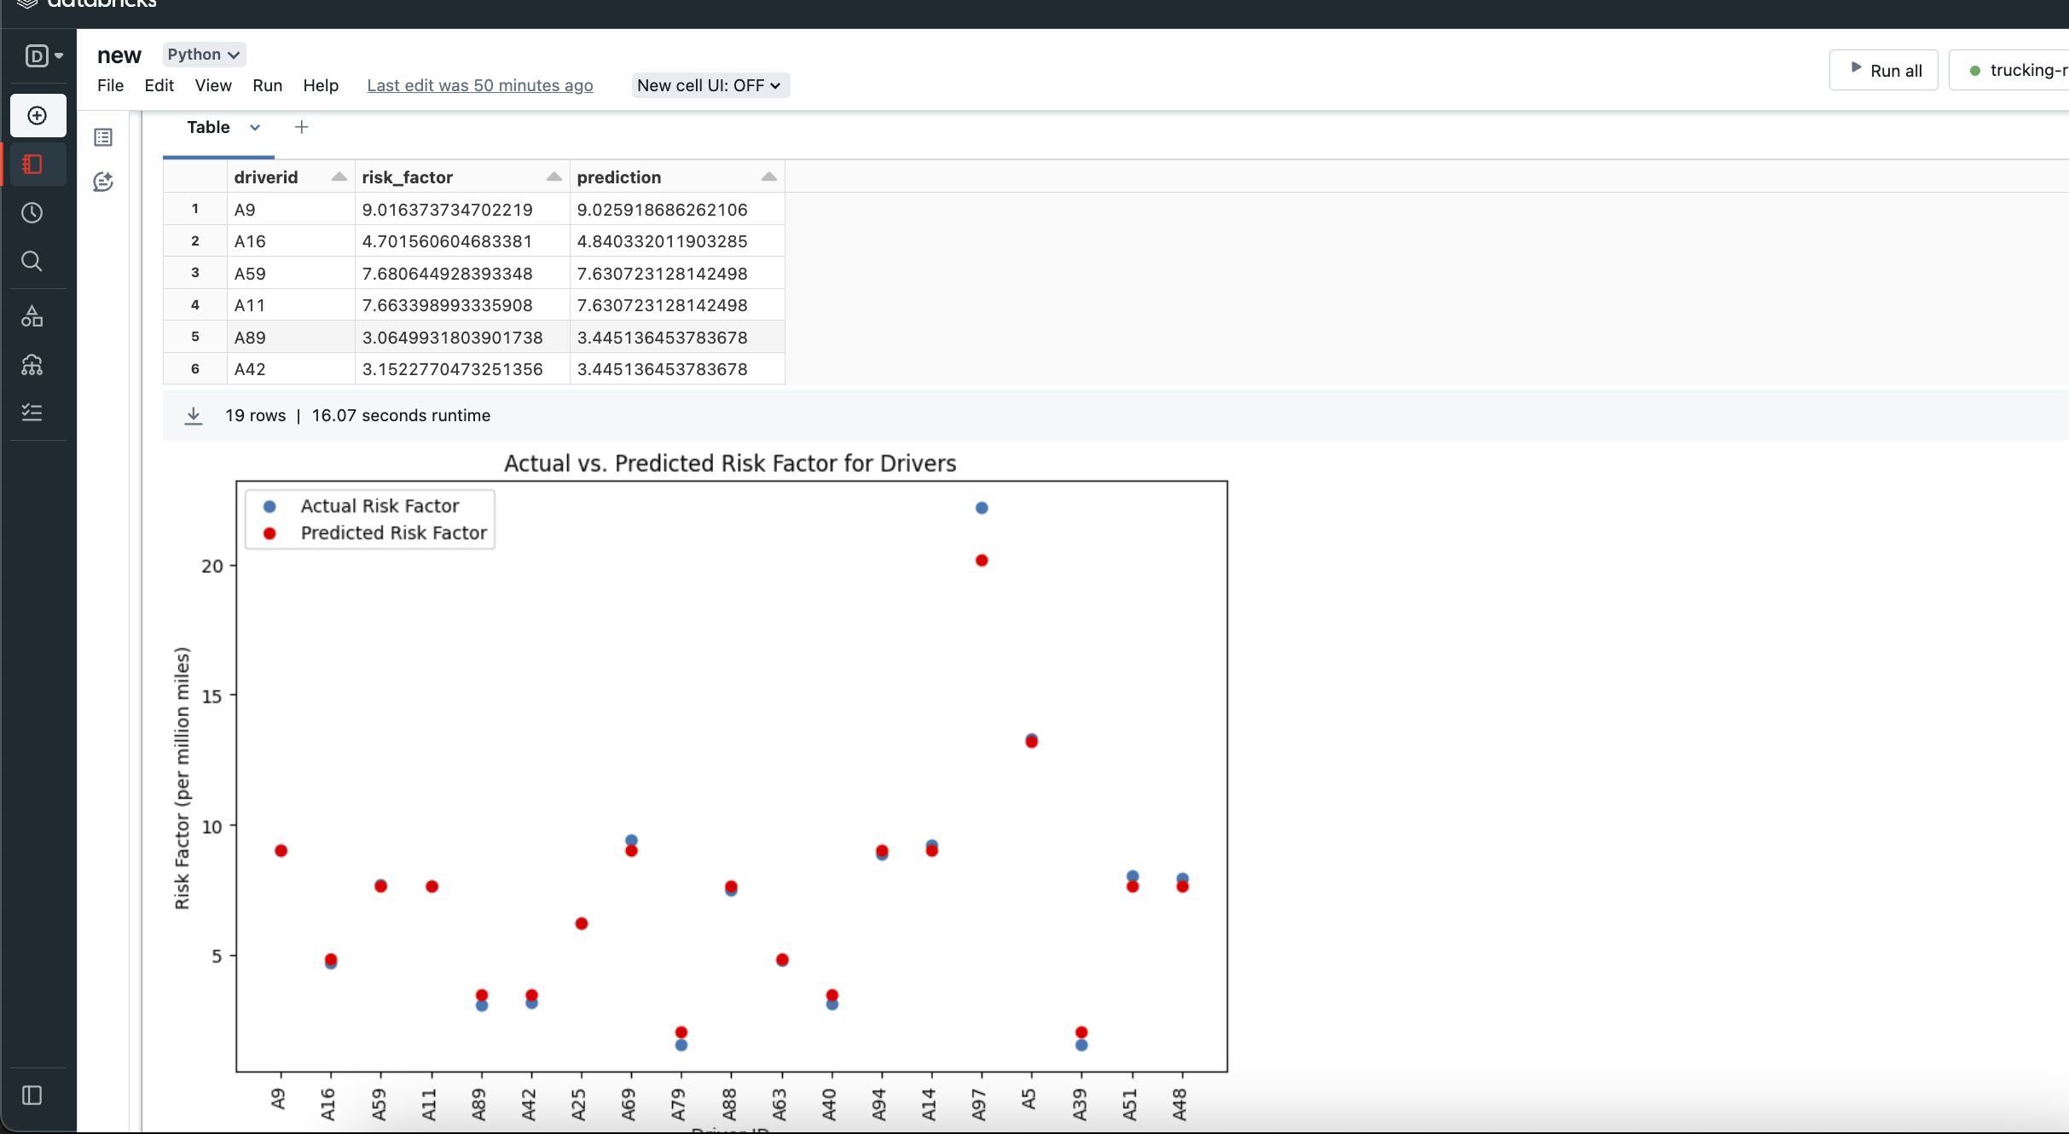
Driver risk factor prediction

Slide 28
Conclusion
Efficiency Recognition: The project figures out which truck drivers use less fuel while driving. This helps reward the best drivers and teaches the ones using more fuel how to improve, saving money on fuel costs.
Safety Enhancements: The study found that lane changing and following too closely are the most common risky behaviors. By training drivers specifically on these issues and monitoring them in real-time, these dangerous habits can be reduced, making the roads safer.
Geographical Insights: Risky driving happens more in cities due to busy streets and complicated routes. Working together with city traffic controllers to address these specific challenges can help reduce accidents and improve safety.
Risk Management: By figuring out which drivers are more likely to be involved in accidents (high 'Risk Factor'), specific actions like extra training or more frequent car checks can be taken to help these drivers be safer.

Slide 29
Thank You

